Slide 1
Cloud Economics
PARTNER TRAINING PROGRAM
Juan Carlos Galván Marín
Cloud Economics BUSINESS DEVELOPMENT MANAGER

Slide 2
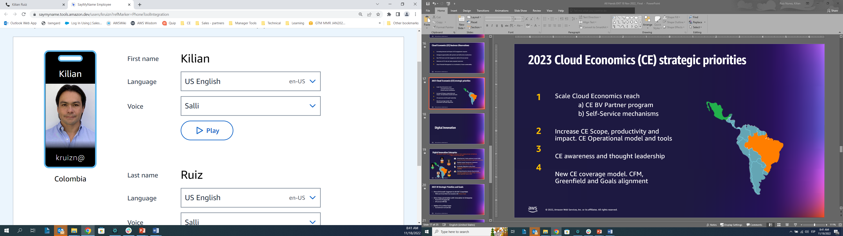
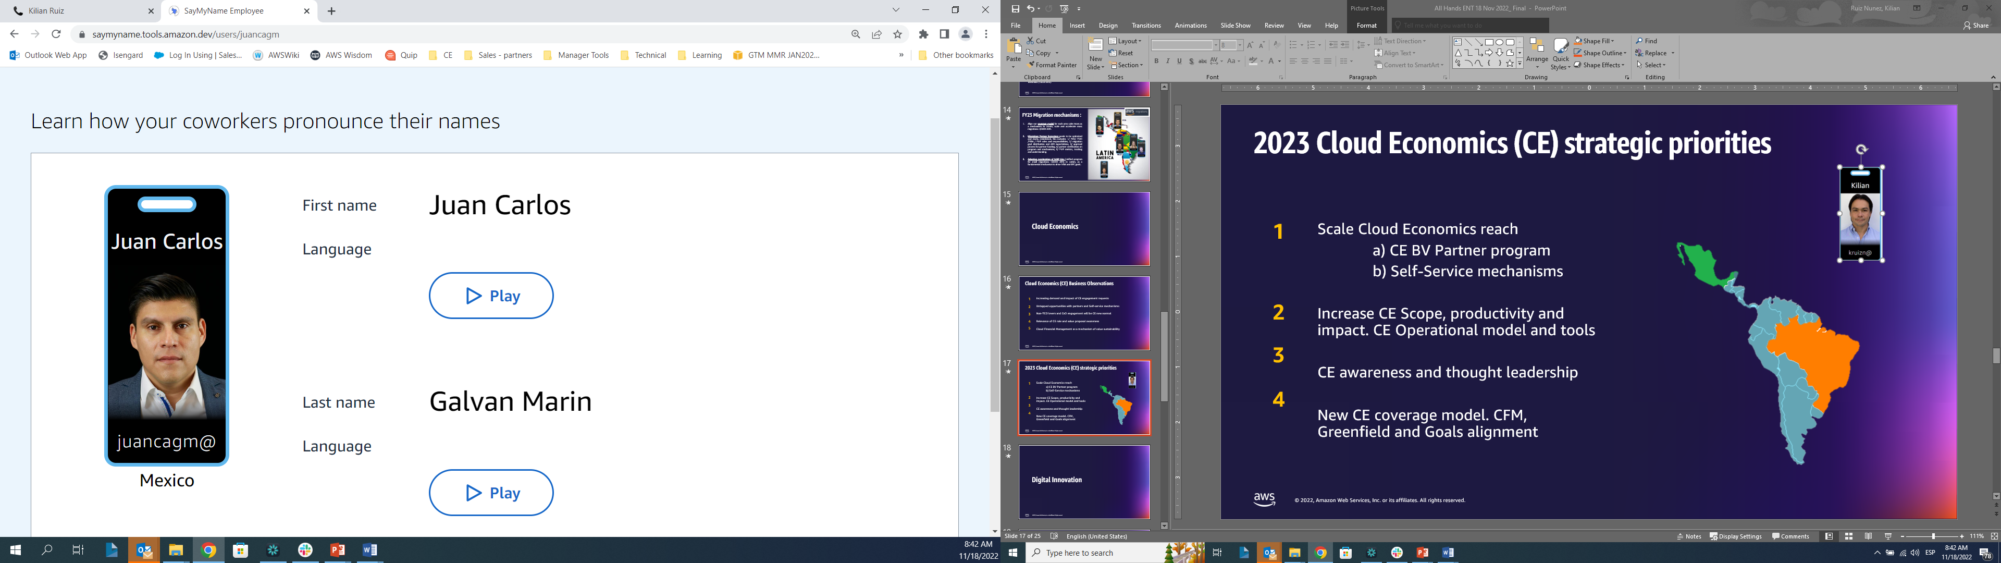
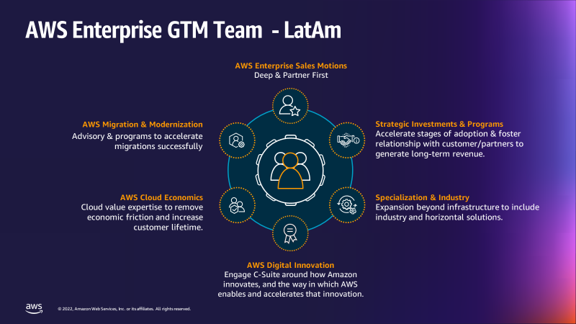



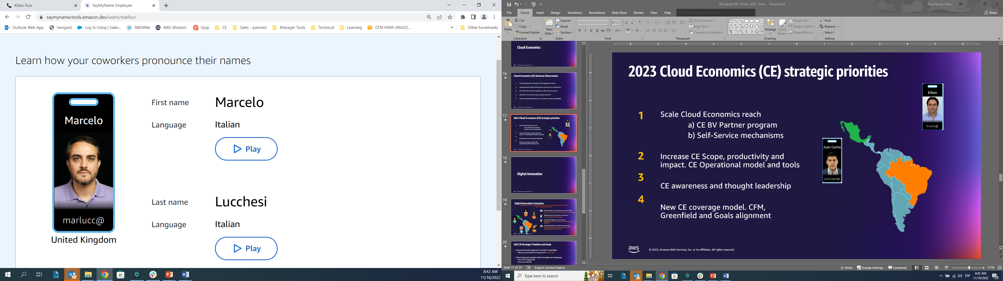

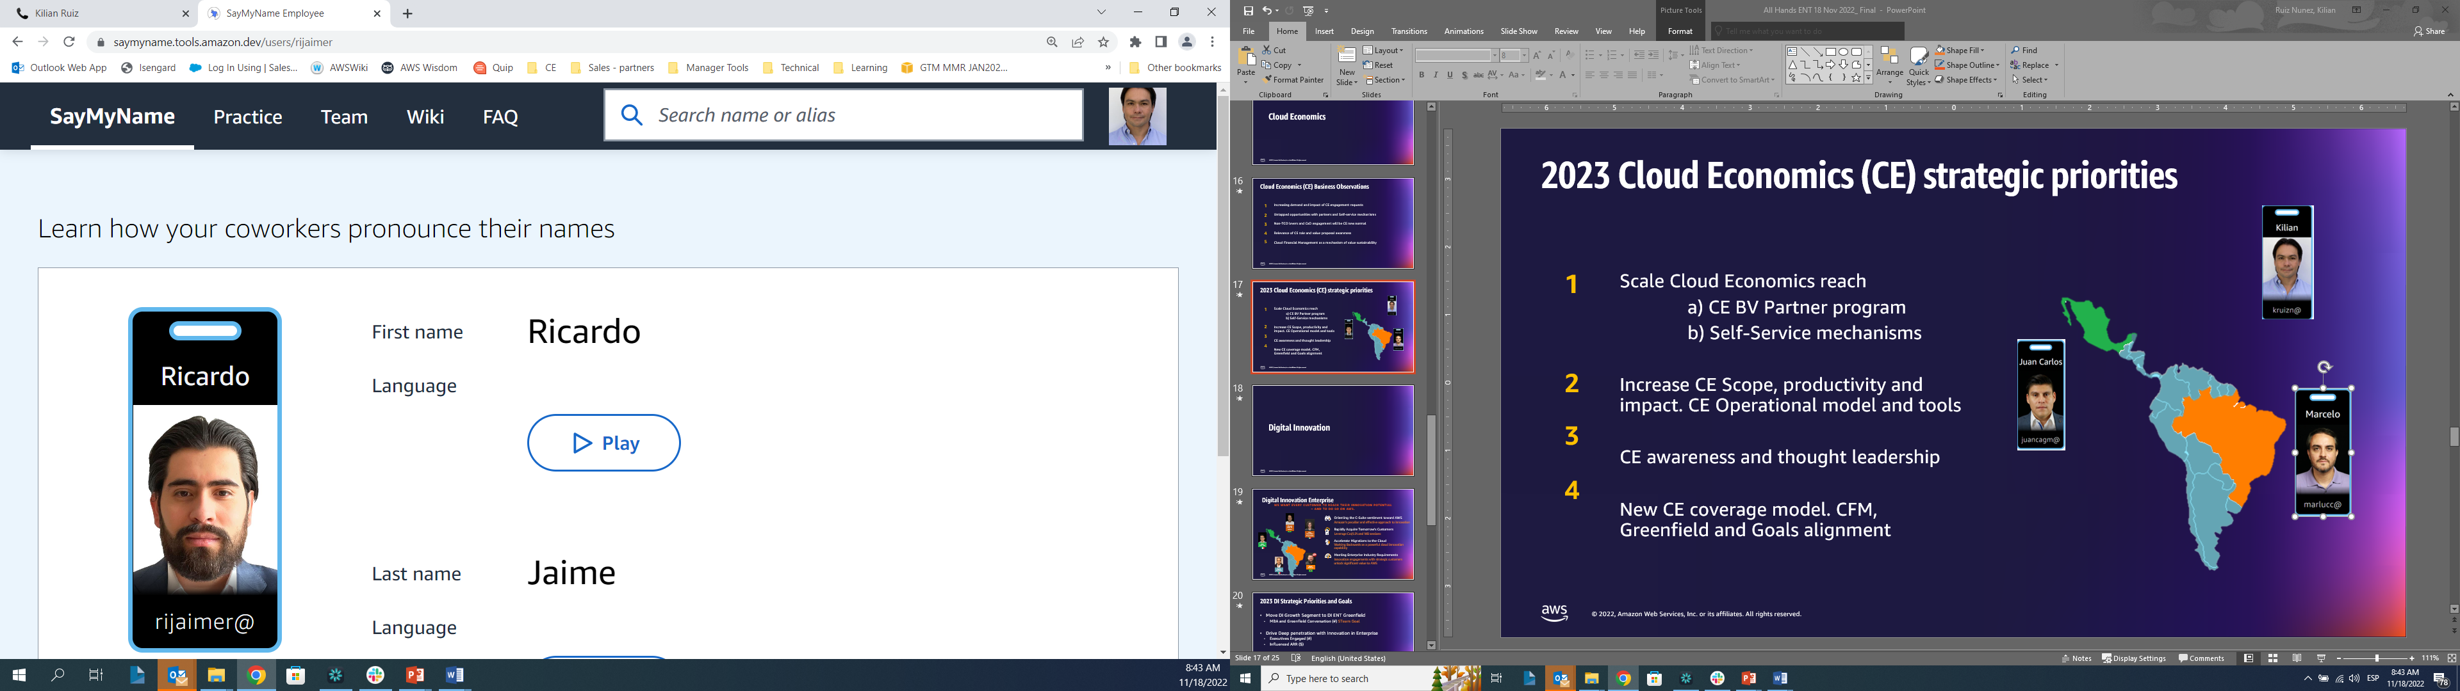

Cloud Economics team
Part of the Enterprise GTM Team - Latam
CE Global structure:
50+ resources NAMER (BV/CFM, Tooling and Benchmarking)
20+ EMEA
10+ APJ
LatAm Manager
ENT - GF
CE MEX
ENT - GF
CE BRA
ENT - GF
CE MCO
ENT - GF

Slide 3
The Objective of this training
Cloud Economics
What is it?
What is business value?
What is Cloud Financial Management?
What value can we povide?
How to become a truster advisor?
How to improve my business?
How to improve my win rate?
Notes:
Cuanto tiempo aproximadamente le invierten a una oportunidad
Cuanto tiempo pasa hasta entregar el primer número
Cuanto tiempo pasa para conseguir la aprobación de un assessment

Slide 4





What is in the scope?
Mixture of on demand videos, AWS consulting guidance & hands-on sessions to help you:
Why Cloud Economics will help you to accelerate your business
Leverage free AWS templates and tools for data collection, mapping and pricing
Get access to consulting content to improve your business
Tackle CXOs challenge & most important financial metrics to decision making
Gain hands on experience in calculating optimized migration Business Cases

Slide 5




What is in for you?
Tools and best practices for calculating Business Cases and leveraging AWS investment programs to:
Increase your Cloud Economics knowledge
Increase Business Case accuracy and comprehensiveness
Increase win rates and deal sizes
Increase downstream revenue opportunities

Slide 6
Program structure and engagement commitment
Areas | Key Aspects | Format | Time Commit
 | Advance non-technical best practices for migrate large-scale workloads. | On demand videos | 3.5 h
 | You will learn advance non-technical best practices for migrate large-scale workloads. | Live sessions for tools On demand videos for templates | 4 h
 | Summary of what we have learned from cloud economics, how does Cloud Economics do it | Live session | 40 min
 | You will learn what is important to hear for CXOs, the most important financial metrics for project analysis and decision-making | Live session | 30 min
 | Business case cost optimization levers including guidance on implementation | On Demand Live session | 25 min
 | Hands-on experience calculating a business case using the tools and templates explored during the training | Live session to set the scene and to discuss the outcomes Self-study and business case prep | 6 h
Cloud Economics
Accreditation
Partner Migration Business Case
Cloud Economics Overview
Financial Overview
AWS Cost
Optimization Levers
Case Study Practice
Engagement Commitment
2-3 candidates completing full curriculum
AWS PDM Supervision & Cloud Economics accompaniment
15h

Slide 7
How can I support our Partners?
AWS One Team

Slide 8
How can I support our Partners?

Slide 9
What do we need from you?
Partner

Slide 10
Champion Suggested Job Description
Key job responsibilities
Champion Profile
Own and drive strategy for Cloud Economics
Serve as a Champion to adopt AWS CE practice to directly support top deals, articulating the economic value of cloud to customers.
Building a seamless end to end Customer journey through the various stages of the purchasing and cloud adoption cycle
Develop a template for deriving the cloud economics business value and turning that into a customer-facing presentation
Partner with the Sales Team team and AWS Team advisors to implement and mature templates and process.
Serve as a key source of market insights into how our customers view the economic benefit of AWS.
Prepare and present internal business reviews to senior management teams regarding progress and roadblocks on economic-related issues facing our customer
Understanding of AWS product line, customer on-premise IT infrastructure, and experience in building business cases which quantify industry specific benefits highly desired.
Provable experience in engineering, management consulting or financial modeling & business economic analysis experience.
Experience creating and presenting business cases to non-technical decision makers.
Understanding of AWS product line, customer on-premise IT infrastructure, and experience in building business cases which quantify industry specific benefits highly desired
Experience working with C-Suite executives.
Strong business sense capable of understanding the complexities of IT environments
Ability to work effectively across internal and external organizations, including sales, marketing, business development and training
Experience leading data-driven analyses and influencing results
Notes:
Strong verbal and written communication skills

